Slide 1





Python HTTP API for use with
GitHub Codespaces
September 2022 | @author
Notes:
By opening this template respository in Codespaces, you can quickly get hands-on with a Python web app that serves an HTTP API using the FastAPI framework. You'll get to focus on working with the project instead of setup and configuration.
[Optional but this is just if you need it]
Learn more about APIs -> An API (Application Programming Interface) describes a way for two computers to interact. An HTTP API allows an Internet-connected computer to send an HTTP request to another Internet-connected computer and receive a response. For example, my computer could send a request to http://a-weather-website-api.com/api/city=Los+Angeles and receive back data like {"high": 72, "low": 66}.
HTTP APIs often provide either data or functionality that's unique to a service, like the example API for the weather website. A weather website could provide additional API endpoints for other weather-related functionality, like upcoming forecasts or historical data. Any website can decide to offer an API if it thinks it has helpful functionality to share with other computers. In this project, you'll run an HTTP API that generates a random token.

Slide 2
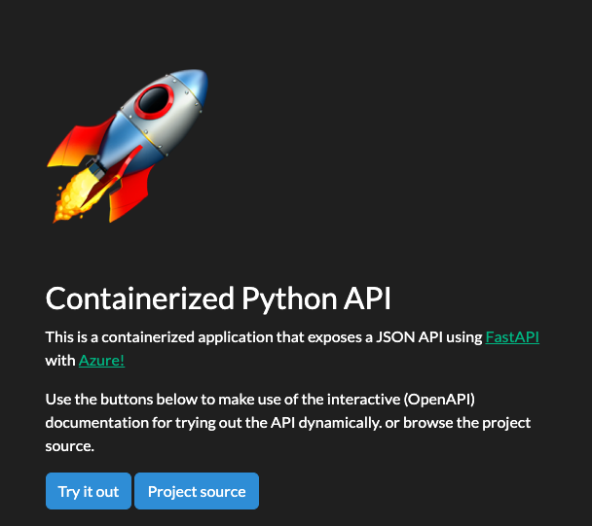

Python HTTP API for use with GitHub Codespaces
This template is also ready to be used with Codespaces, a developer environment running in the cloud with Visual Studio Code.

Slide 3

Hi, I'm ___!
Gold Microsoft Learn Student Ambassador.

Slide 4


Here are the key files and folders that make it happen:
webapp/
.devcontainer/Dockerfile
.devcontainer/devcontainer.json
For students and Developers
Notes:
Using Codespaces, you get Visual Studio Code in the cloud, using a "developer container". Like a locally running version of Visual Studio Code, the cloud version also allows you to install extensions and use a terminal.
You can also configure your developer container to run a specific runtime and have it boot up with your favorite extensions.
Here are the key files and folders that make it happen:
webapp/: The HTTP API code, built with the FastAPI framework.
.devcontainer/Dockerfile: Configuration file used by Codespaces to determine operating system and other details.
.devcontainer/devcontainer.json, A configuration file used by Codespaces to configure Visual Studio Code settings, such as the enabling of additional extensions.

Slide 5

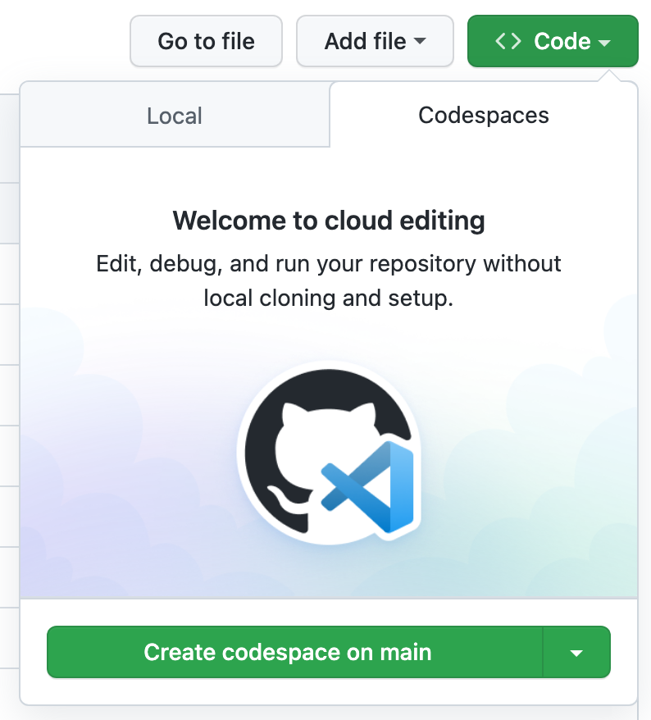
Try it out
Create a repository from this template. Use this create repo link. You can make the repository private or public, up to you.
Navigate to the main page of the newly created repository.
Under the repository name, use the Code drop-down menu, and in the Codespaces tab, select "Create Codespace on main".
Notes:
Try out this template repository using Codespaces following these steps:
Create a repository from this template. Use this create repo link. You can make the repository private or public, up to you.
Navigate to the main page of the newly created repository.
Under the repository name, use the Code drop-down menu, and in the Codespaces tab, select "Create Codespace on main".

Slide 6
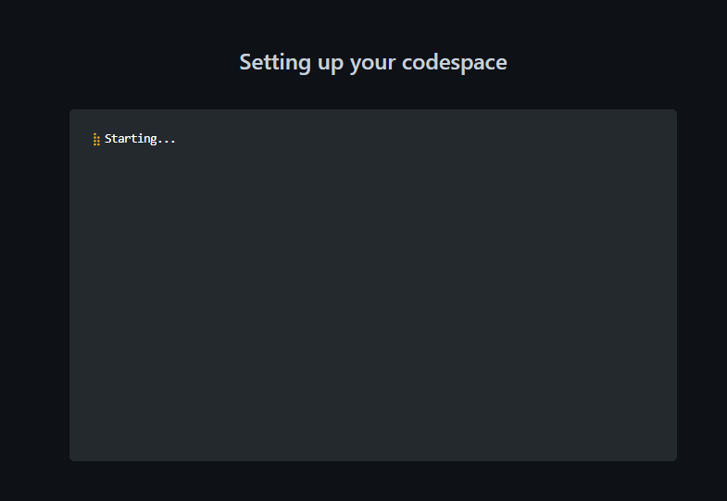
Try it out
4. Wait as GitHub initializes the codespace.
Notes:
4. Wait as Github initializes the codespace

Slide 7
Inspect your
Codespaces environment
Notes:
What you have at this point is a pre-configured environment where all the runtimes and libraries you need are already installed - a zero config experience.

Slide 8

Running the App
Notes:
This Python application is using FastAPI, a powerful web framework that self-documents its API endpoints. The API has only one endpoint that generates a unique pseudo-random string that can be used as a token.

Slide 9

Customize
the Codespace
Notes:
You can change your environment and the text editor so that the next time you create (or rebuild) the environment, everything will be set automatically.

Slide 10

Customize
the Codespace
Changing the Python version
Adding or modifying a pre-installed editor extension
Notes:
Let's go through two different challenges that you are likely to want to do:
Changing the Python version
Adding or modifying a pre-installed editor extension

Slide 11
Open .devcontainer/devcontainer.json and replace the following section:
Option 1
“VARIANT”: “3.8-bullseye”
Changing the Python version
With the following instruction:
“VARIANT”: “3.9-bullseye”
Notes:
Let's say you want to change what version of Python is installed. This is something you can control.
Open .devcontainer/devcontainer.json and replace the following section:
"VARIANT": "3.8-bullseye"
with the following instruction:
"VARIANT": "3.9-bullseye“
this change will use Python 3.9 instead of 3.8.

Slide 12
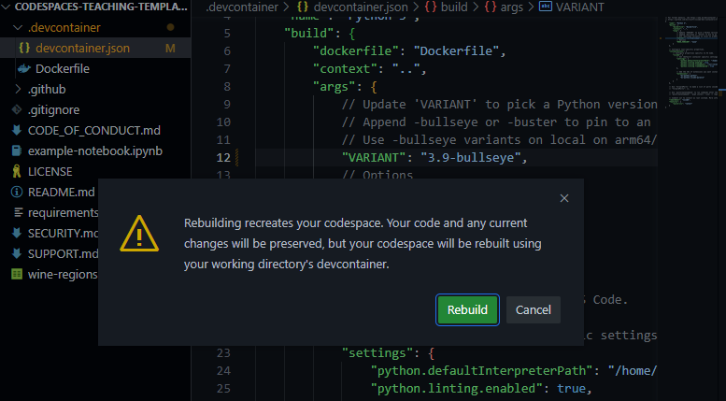
Remainder: When you change any configuration on the json, a box will appear after saving.
Notes:
Remainder: When you change any configuration on the json, a box will appear after saving.
Click on rebuild. Wait for your codespace to rebuild the VS Code environment.

Slide 13
Option 2
Add an extension
1. Open file .devcontainer/devcontainer.json and locate the following JSON element extensions:
"extensions": [
"ms-python.python",
"ms-python.vscode-pylance"
]
Notes:
Your environment comes with preinstalled extensions. You can change which extensions your codespaces environment starts with, here's how:
Open file .devcontainer/devcontainer.json and locate the following JSON element extensions:
"extensions": [
"ms-python.python",
"ms-python.vscode-pylance"
]

Slide 14
Option 2
Add an extension
2. Add "ms-python.black-formatter" to the list of extensions. It should end up looking like the following:
"extensions": [
"ms-python.python",
"ms-python.vscode-pylance",
"ms-python.black-formatter"
]
Notes:
2. Add "ms-python.black-formatter" to the list of extensions. It should end up looking like the following:
"extensions": [
"ms-python.python",
"ms-python.vscode-pylance",
"ms-python.black-formatter"
]
What you did above was to add the unique identifier of an extension of the Python Black Formatter extension. This will let Codespaces know that this extension should be pre-installed upon startup.

Slide 15
Remainder: When you change any configuration on the json, a box will appear after saving.
Notes:
Remainder: When you change any configuration on the json, a box will appear after saving.
Click on rebuild. Wait for your codespace to rebuild the VS Code environment.

Slide 16




Navigate to the extension's web page
For example, Black Formatter.
To find the
Unique identifier of an extension
Locate the Unique Identifier field
Under More info section on your right side.
Notes:
To find the unique identifier of an extension:
Navigate to the extension's web page, for example https://marketplace.visualstudio.com/items?itemName=ms-python.black-formatter
Locate the Unique Identifier field under More info section on your right side.

Slide 17
Next steps
Make sure you have an Azure account already.
Sign in to your Azure account
Create a (no Credit Card required) Azure For Students account
Create a new Azure account
Notes:
Take this API application to the next level and deploy it to the cloud! For this learning challenge you'll use a FREE deployment option for Azure and GitHub Actions for the automation.
Before continuing, make sure you have an Azure account ready. Select any of the following:
Sign in to your Azure account
Create a (no Credit Card required) Azure For Students account
Create a new Azure account

Slide 18
Practice more
You can continue to practice and learn with the following examples:
Create an Azure App Service
Create an Azure Service Principal
Setup GitHub Actions
Deploy your app
Notes:
There are a few steps involved, so make sure you get everything right!
- Create an Azure App Service
- Create an Azure Service Principal
- Setup GitHub Actions
- Deploy your app

Slide 19
Other Resources
FastAPI
Codespaces
Use Dev containers locally

Slide 20

Found an issue or have an idea for improvement?
Help us make this template repository better by letting us know and opening an issue!

Slide 21
Thank you!

Slide 22






Resource Page
Use these design resources in your Presentation. Happy designing!
Don't forget to delete this page before presenting.

